Slide 1
BE Project Presentation On “SECURE E WALLET ARCHITECTURE USING BLOCKCHAIN TECHNOLOGY”
Presented by
Jay Pardeshi 71834755C
Jay Sharma 71834756M
Sunil Bhadu 71917204H
:Atharva Tribhuwane 71835034M
Guided By
Prof. Rajesh Tak

Slide 2
Problem Statement
To develop an android based wallet for secure mobile money using block chain technology using JSP & servlet technology.

Slide 3
Problem Definition
There are numerous such instances, where investors have lost their hard-earned money with banks owing to financial mismanagement at banks and consequently, the Reserve Bank of India (RBI) taking Prompt Corrective Action (PCA) against them. Currently, UCO Bank, United Bank of India, Central Bank of India, Indian Overseas Bank, Punjab & Maharashtra Co-operative (PMC) Bank, to name a few are under the PCA of the RBI.
The track record of co-operative banks has been horrific. According to RBI data, there were 1,926 Urban cooperative Banks (UCBs) in 2004; and over the last 16 years, the RBI was compelled to merge 129 weaker cooperatives with stronger banks. Nearly 246 UCBs collapsed over the last 16 years.

Slide 4
Introduction
The process of making financial transactions includes many banks which can take several working days. Our proposed system, has a goal to make bank transactions faster, more secure.
This will make it possible to work with a decentralized blockchain instead of using the bank systems which is being used today.
For that purpose we are going to develop a prototype system including an android application for user, a web base application for admin using Java programming language.
Algorithms used will be SHA 256, and AES 128 bit.

Slide 5
Objectives
1. To learn & understand BCT implementation using Java.
3. To use AES for database encryption.
4. To use SHA 256 for hash generation.
5. To use JSP & Servlet technology.
To implement an android application for user.
To implement a web application for bank and admin.

Slide 6
Motivation
Imagine this scenario: You invested Rs 10 lakh in a bank fixed deposit for tenure of 2 years. The interest every quarter for seven quarters was earned/received by you, but just a few months before the deposit was about to mature, the bank owing to multiplying financial troubles ( which ultimately led to the banking regulator impose some controls) didn't pay your hard-earned money on the date of maturity.

Slide 7
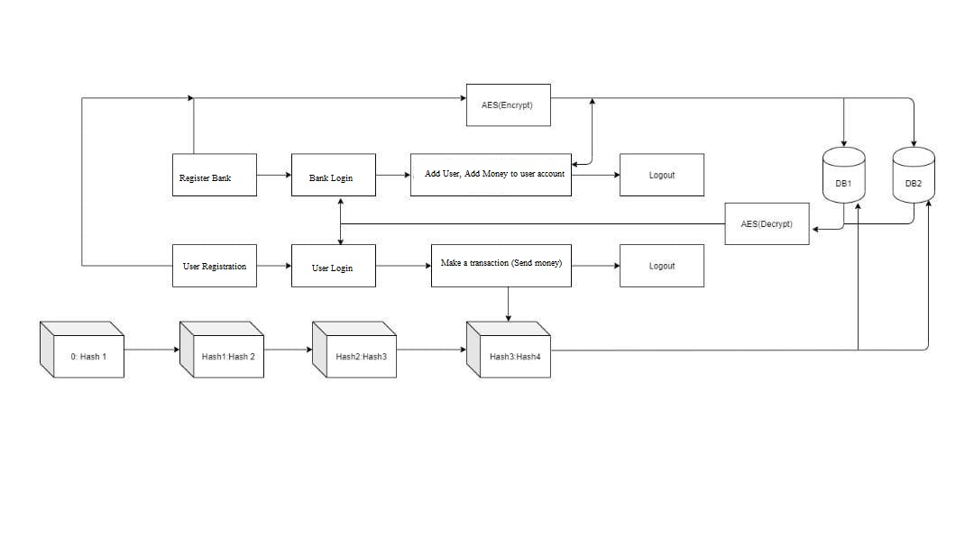
SYSTEM ARCHITECTURE

Slide 8
SYSTEM ARCHITECTURE
Whenever any transaction will occur in the system , the record of that transaction is maintained in the form of hash value in a block. Each next block will get attached to the previous block and in this way a virtual block chain will occur.
The hash value of a current block is generated using the data of a current block and the hash of the previous block. In this way if any of the block is tempered the subsequent all the blocks hash must be changed .
Such multiple copies are maintained at different servers , which will assure the data security and confidentiality. As everything is through application interface, it will maintain the transparency in transaction.

Slide 9
TECHNICAL SPECIFICATION OF PROJECT
Hardware Specification
RAM: 4GB
HDD: 250GB

Slide 10
TECHNICAL SPECIFICATION OF PROJECT
Software Specification
JDK 1.8
MYSQL
NETBEANS
APACHE TOMQAT SERVER

Slide 11
ALGORITHMS: SHA 256
SHA-256 (secure hash algorithm, FIPS 182-2) is a cryptographic hash function with digest length of 256
bits. It is a keyless hash function; that is, an MDC (Manipulation Detection Code).
A message is processed by blocks of 512 = 16 × 32 bits, each block requiring 64 rounds
A cryptographic hash (sometimes called ‘digest’) is a kind of ‘signature’ for a text or a data file. SHA-256 generates an almost-unique 256-bit (32-byte) signature for a text.

Slide 12
ALGORITHMS: SHA 256
A hash is not ‘encryption’ – it cannot be decrypted back to the original text (it is a ‘one-way’ cryptographic function, and is a fixed size for any size of source text).
This makes it suitable when it is appropriate to compare ‘hashed’ versions of texts, as opposed to decrypting the text to obtain the original version.

Slide 13
ALGORITHMS: AES
STEPS:
Derive the set of round keys from the cipher key.
Initialize the state array with the block data (plaintext).
Add the initial round key to the starting state array.
Perform nine rounds of state manipulation.
Perform the tenth and final round of state manipulation
Copy the final state array out as the encrypted data (ciphertext).

Slide 14
ALGORITHMS: AES
The encryption process uses a set of specially derived keys called round keys.
These are applied, along with other operations, on an array of data that holds exactly one block of data, the data to be encrypted.
This array we call the state array.

Slide 15
Conclusion
Thus we are going to implement a prototype android based software application using Java for E wallet which will be secure , transparent and user friendly .
We are going to implement blockchain features such as:
Decentralization using WLAN
Hash Algorithm
Encrypted Database.

Slide 16
REFERENCES
[1] D. Mills et al., “Distributed ledger technology in payments, clearing, and settlement,” Finance and Economics Discussion Series 2016- 095. Washington: Board of Governors of the Federal Reserve System, https://doi.org/10.17016/FEDS.2016.095.
[2] The Financial Industry Regulatory Authority Report, http://www.finra.org/sites/default/files/FINRA Blockchain_Report.pdf, January 2017
[3]http://economictimes.indiatimes.com/articleshow/61715860.cms?utm source=contentofinterest&utmmedium=text&utm_campaign=cppst,November 2017.
[4] S. Nakamoto, “Bitcoin: A peer-to-peer electronic cash system, 2009,” 2012. [Online]. Available: http://www.bitcoin.org/bitcoin.pdf
[5] Z. Zheng, S. Xie, H. Dai, X. Chen and H. Wang., "An overview of blockchain technology: Architecture, consensus, and future trends.“ In 2017 IEEE International Congress on Big Data (BigData Congress), 2017 Jun 25 (pp. 557-564). Honolulu, USA, DOI: 10.1109/BigDataCongress.2017.85

Slide 17
REFERENCES
[6] https://en.bitcoin.it/wiki/Transactions (visited on 05/28/2013).
[7] M. Ober, S. Katzenbeisser, and K. Hamacher., "Structure and Anonymity of the Bitcoin Transaction Graph". Future internet, 5(2):237–250, May 2013
.
[8] http://blockchain.info/de/wallet/send-shared (visited on 05/31/2013).
[9] M. Möser , “Anonymity of Bitcoin Transactions” , An Analysis of Mixing Services . Münster Bitcoin Conference (MBC), 17–18 July 13, Münster, Germany.
[10] V. Dhar and R. Roger, "FinTech Platforms and Strategy " MIT Sloan Research Paper No. 5183-16. Available at SSRN https://ssrn.com/abstract=2892098 or http://dx.doi.org/10.213 9/ssrn.2892098

Slide 18
THANK YOU.

